Slide 1

NSG Pilkington – University of Liverpool Machine Learning Project: 09/06/2021
Dr. Peter Green
Diego Echeverria
Sarini Jayasinghe
Risk Institute,
School of Engineering

Slide 2
Today
Content:
MK4 Scanner Data
ISRA 5D Scanner Data
GP Confidence Bounds
GP with lower relevance inputs removed
Testing data (18/05/2021 to 27/05/2021)
Upskilling:
Linear regression
How do we learn ‘online’?
What actually is a Neural Network?
What is a Gaussian Process?
How does PCA work?
Shannon Entropy

Slide 3
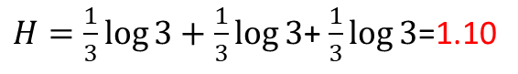
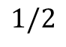
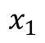
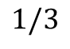
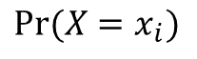
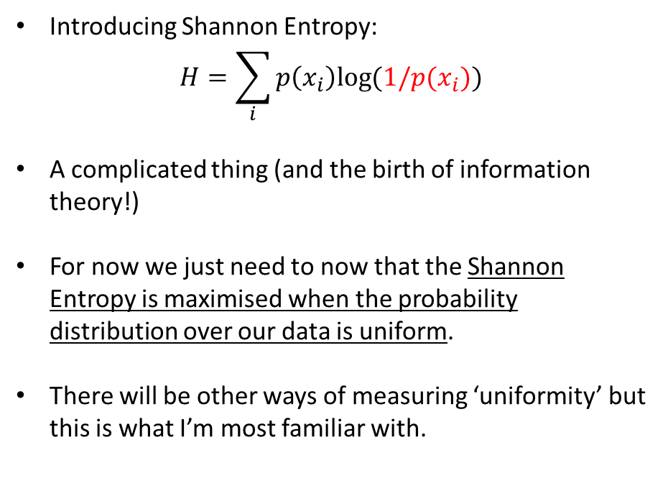
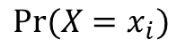
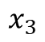
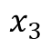
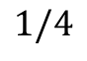
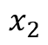
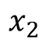
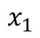
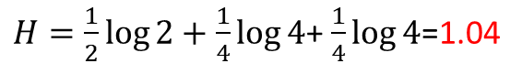
MK4 Fault Scanner Data
$${Pr⁡(X=x}_{i})$$
$$1/3$$
Corrected typo
Introducing Shannon Entropy:
$$H=\sum_{i}{p\left(x_{i}\right)log⁡(1/p(x_{i}))}$$
A complicated thing (and the birth of information theory!)
For now we just need to now that the Shannon Entropy is maximised when the probability distribution over our data is uniform.
There will be other ways of measuring ‘uniformity’ but this is what I’m most familiar with.
$$x_{1}$$
$$x_{2}$$
$$x_{3}$$
$H=\frac{1}{3}\log{3}+\frac{1}{3}\log{3}$+ $\frac{1}{3}\log{3}$=1.10
$${Pr⁡(X=x}_{i})$$
$$1/2$$
$$1/4$$
$$x_{1}$$
$$x_{2}$$
$$x_{3}$$
$H=\frac{1}{2}\log{2}+\frac{1}{4}\log{4}$+ $\frac{1}{4}\log{4}$=1.04

Slide 4
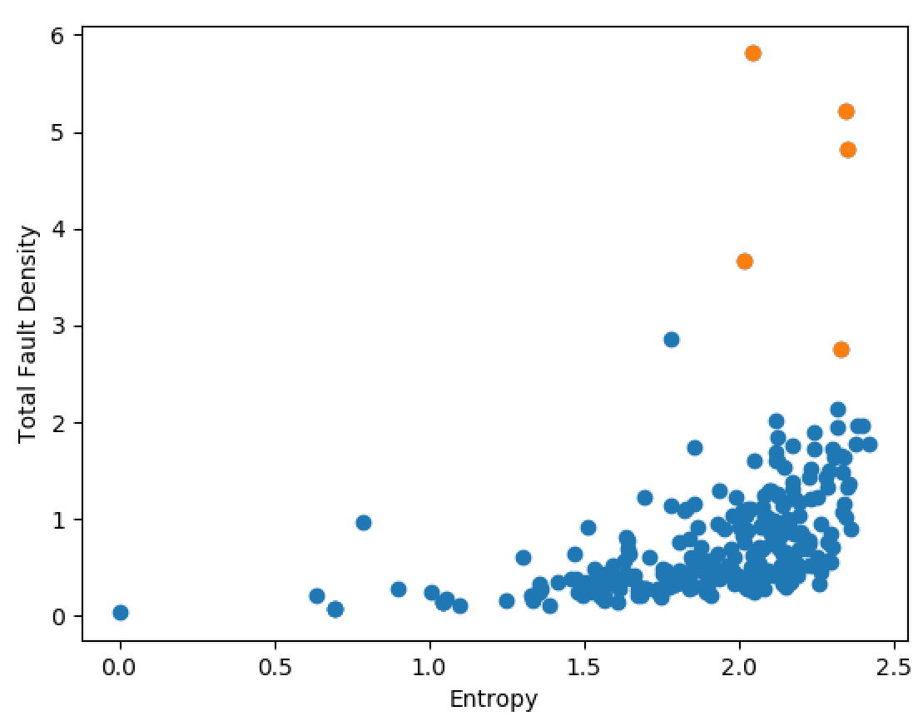
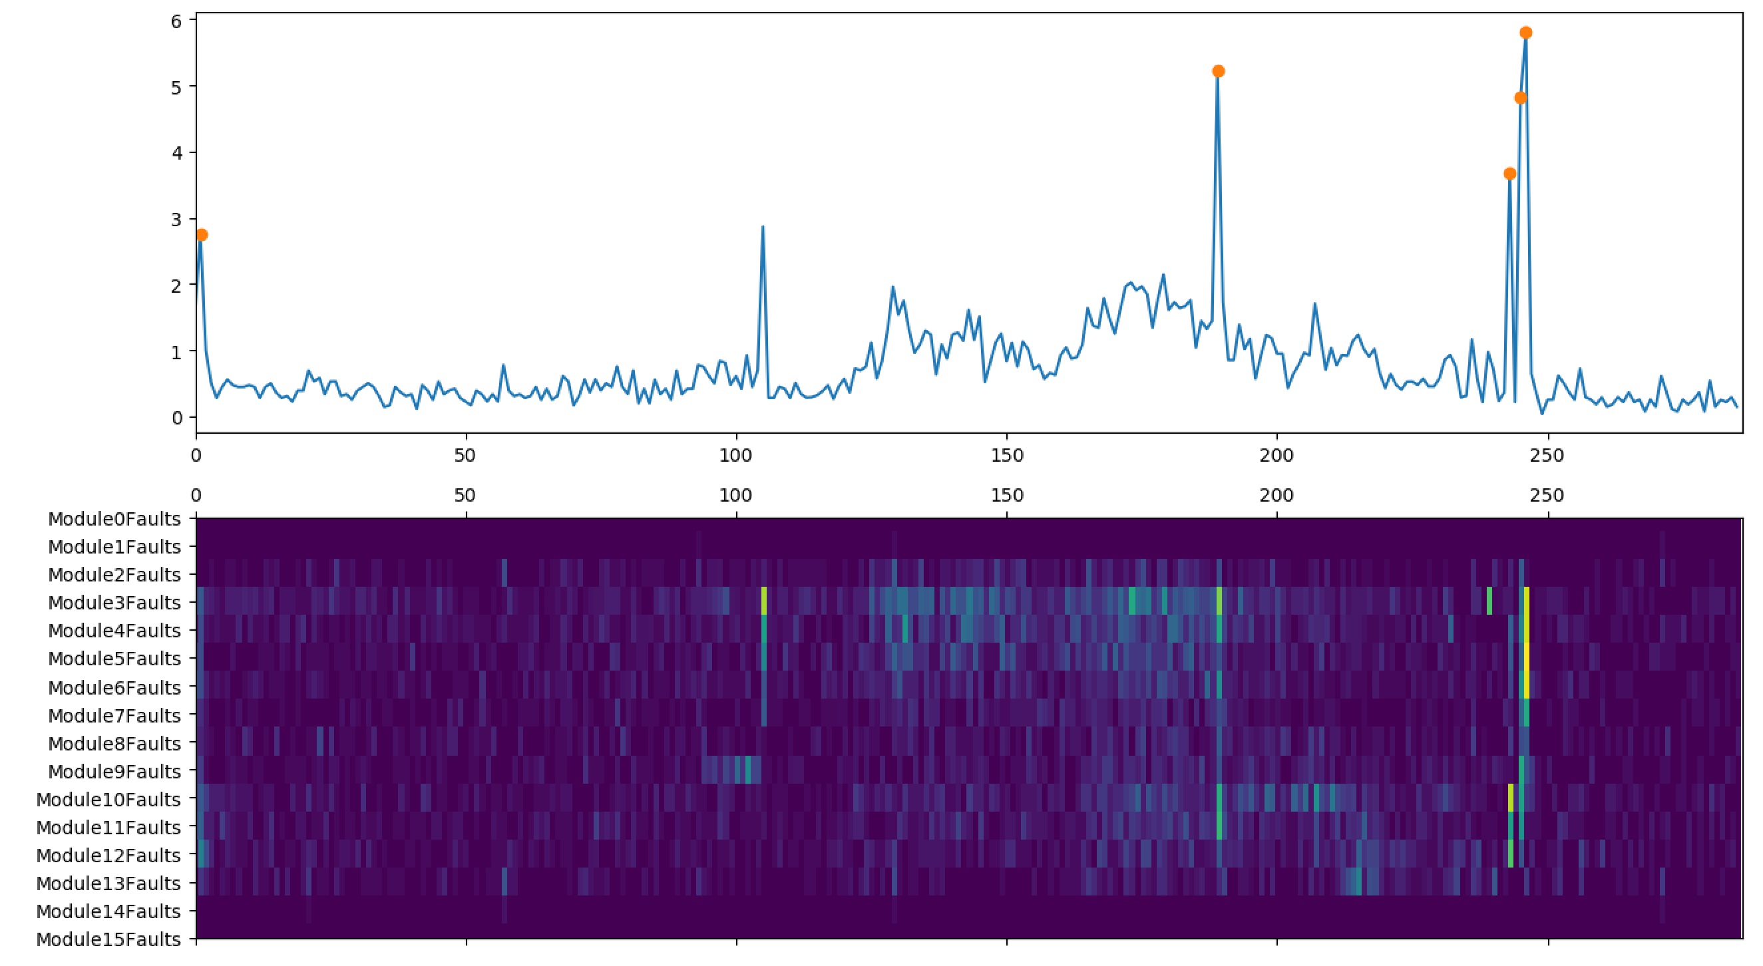
MK4 Fault Scanner Data
Example previous results:
For example, here we identify points that have total fault density > 2.5 and entropy > 2
A ‘spike’ but not a ‘stripe’!

Slide 5
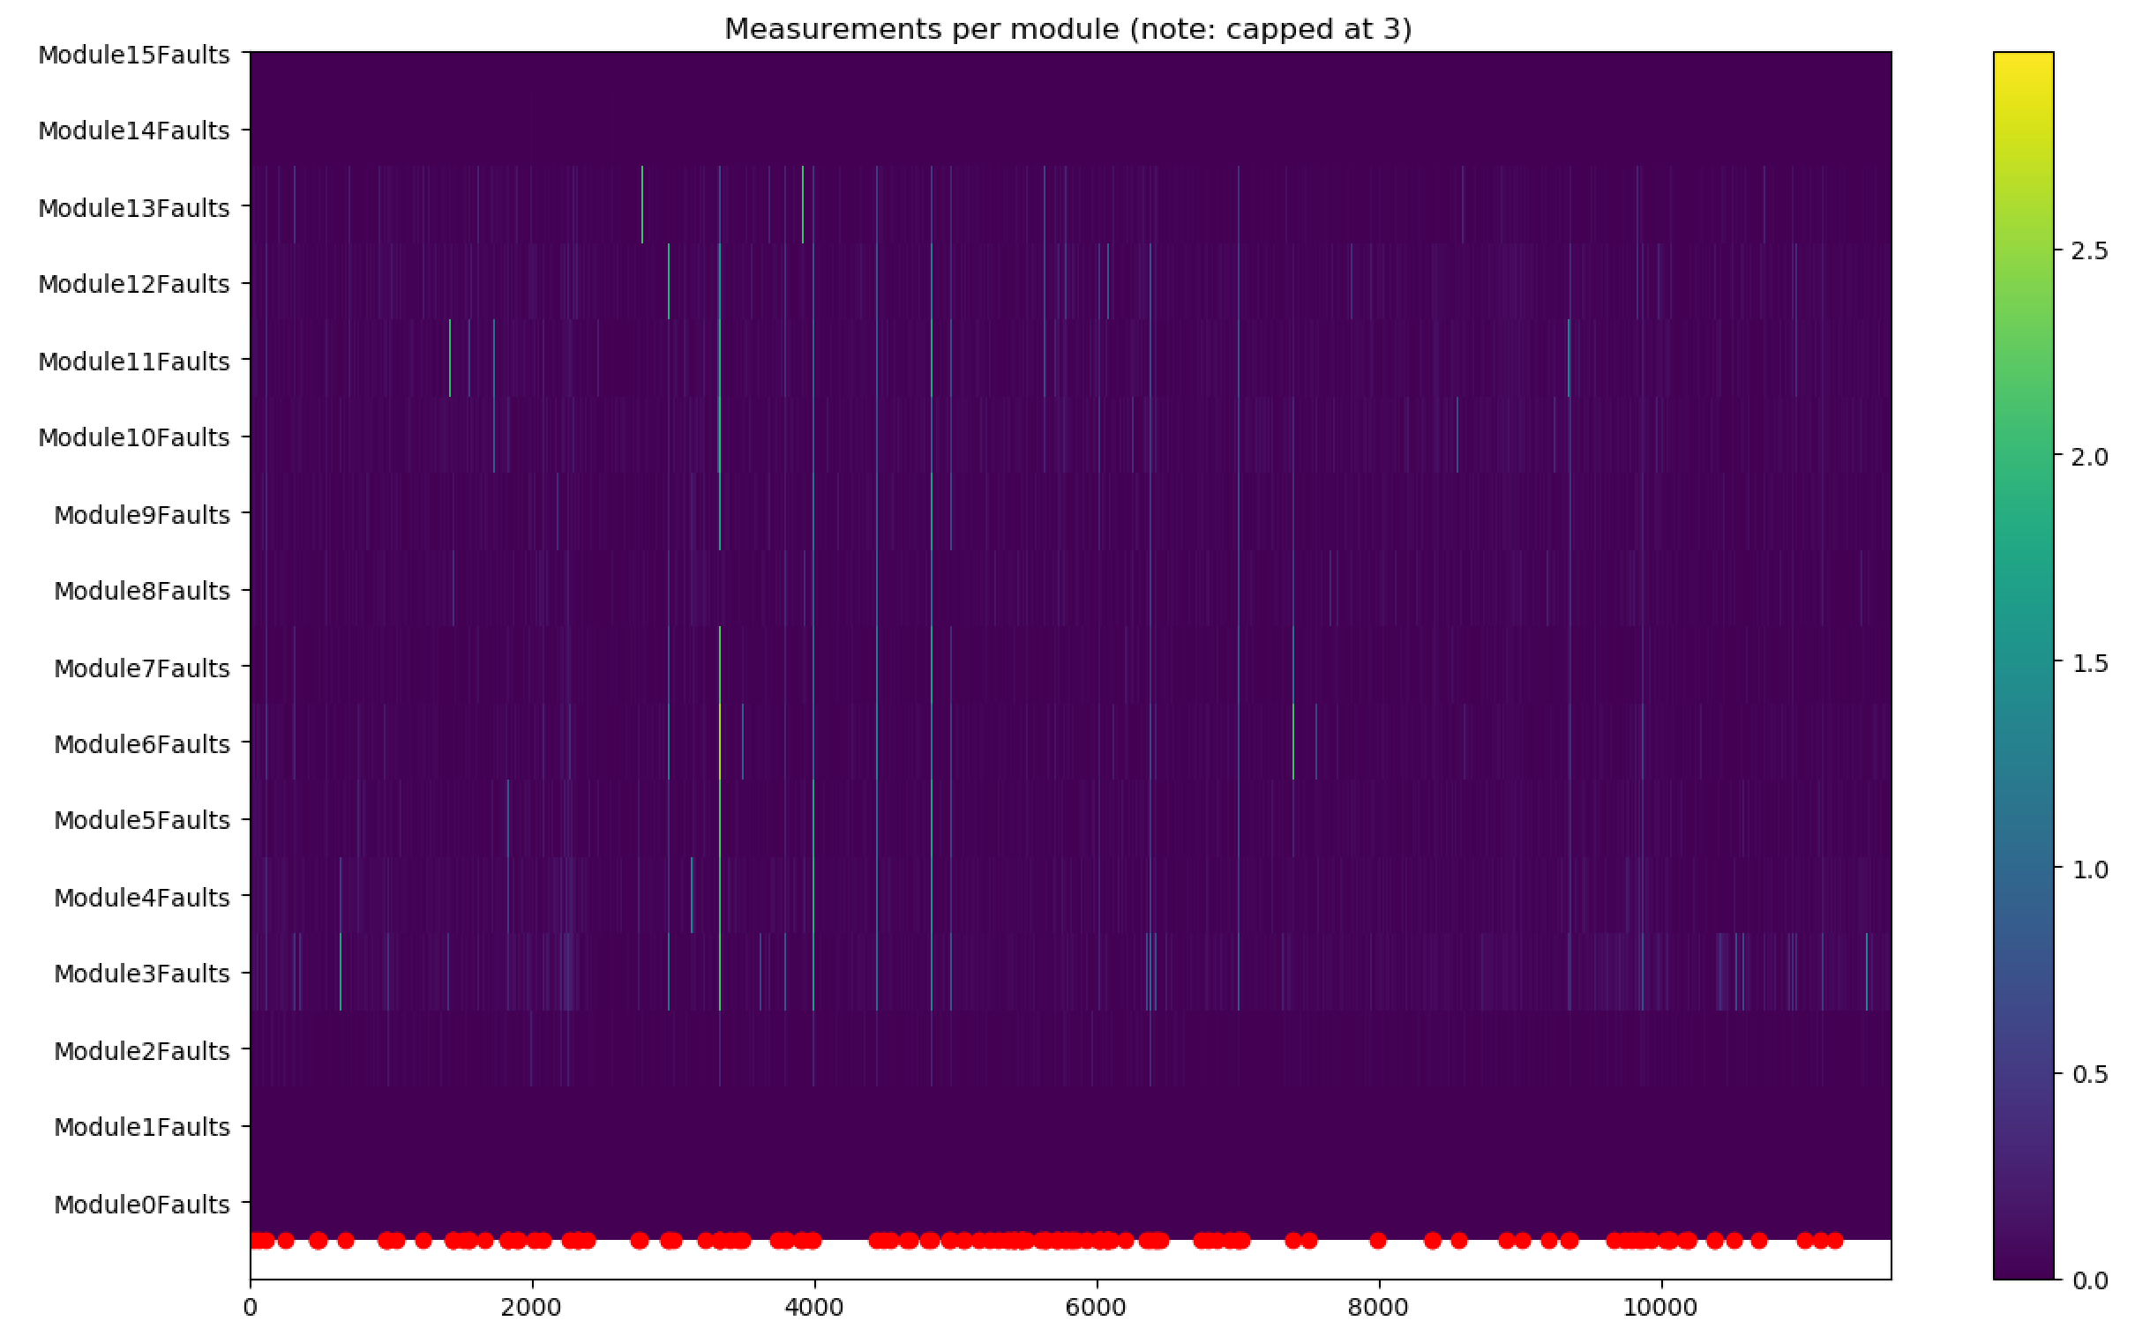
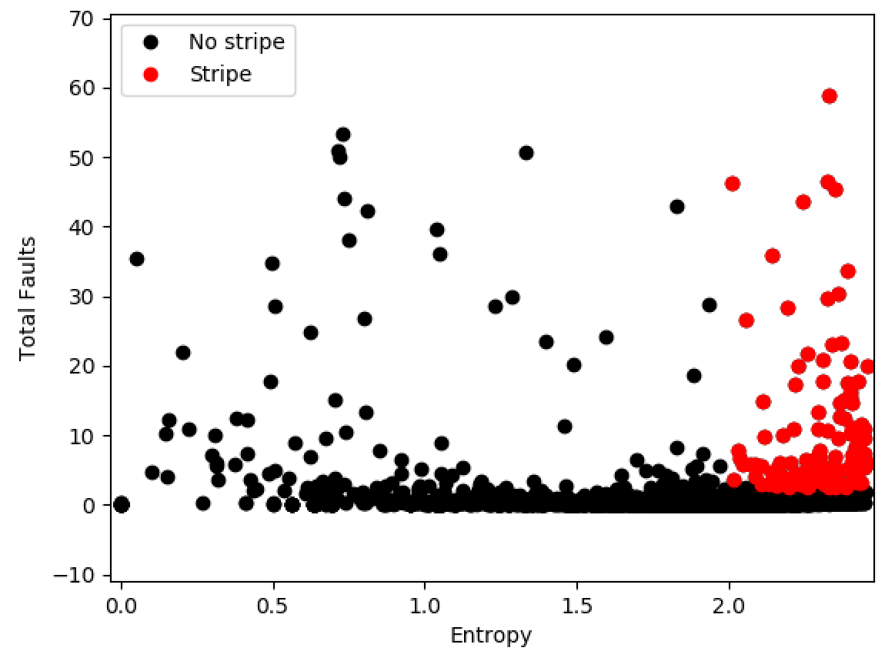
MK4 Fault Scanner Data

Slide 6
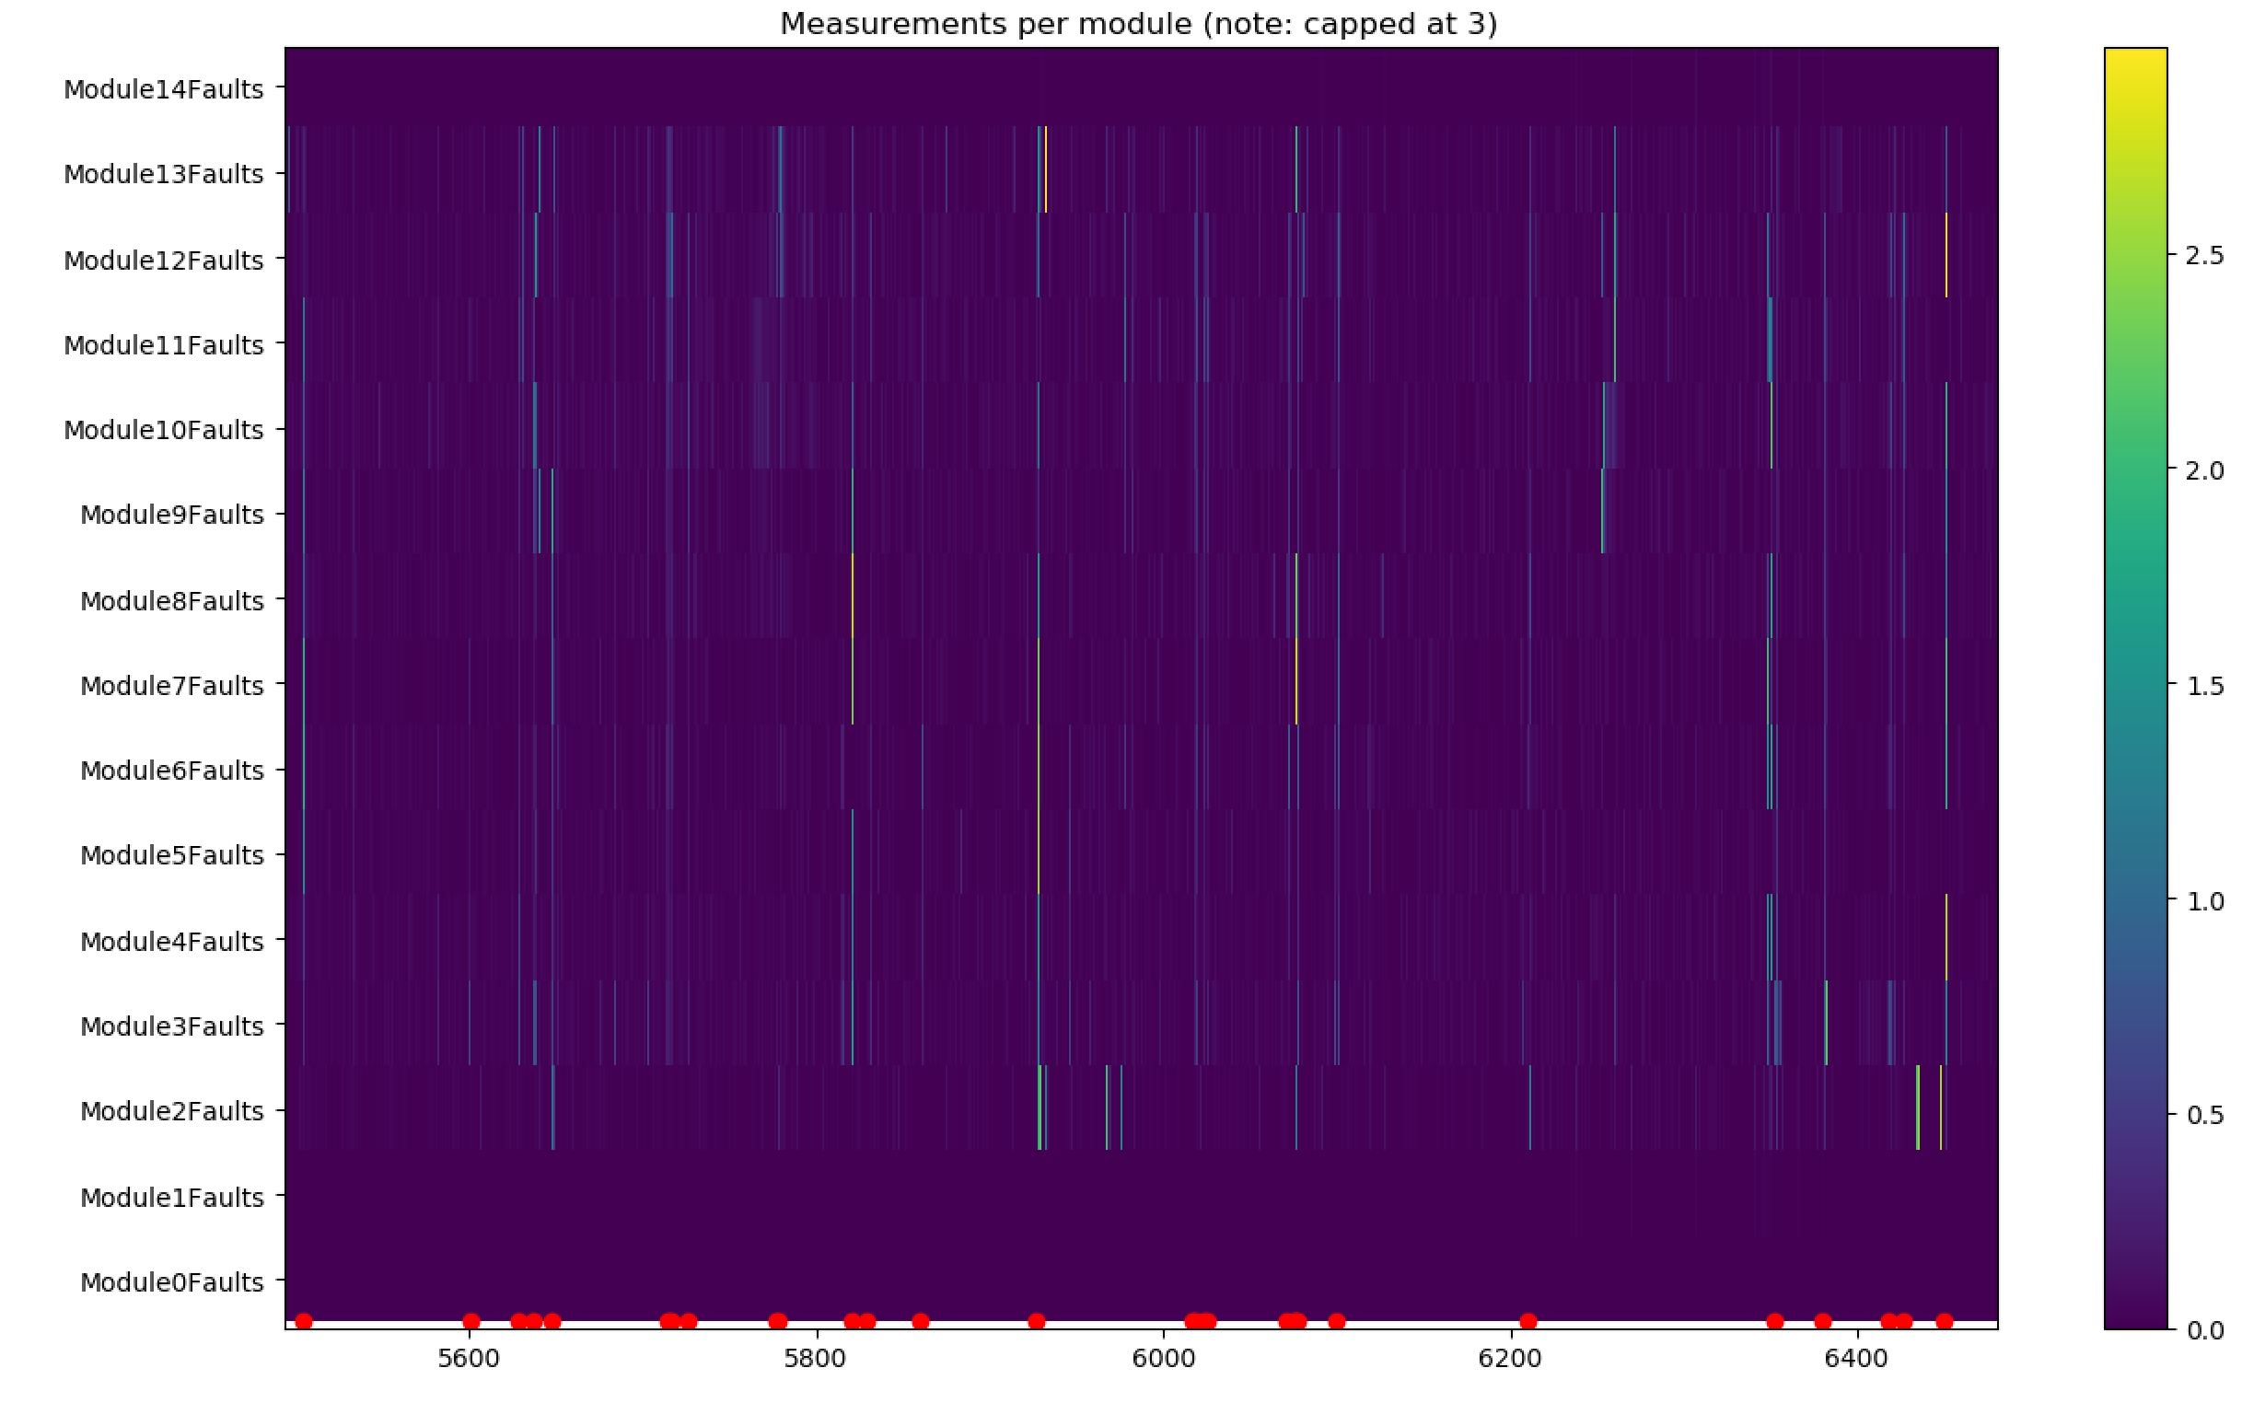
MK4 Fault Scanner Data
The approach does identify and remove points that are not otherwise removed by out ‘remove_spikes’ approach.

Slide 7
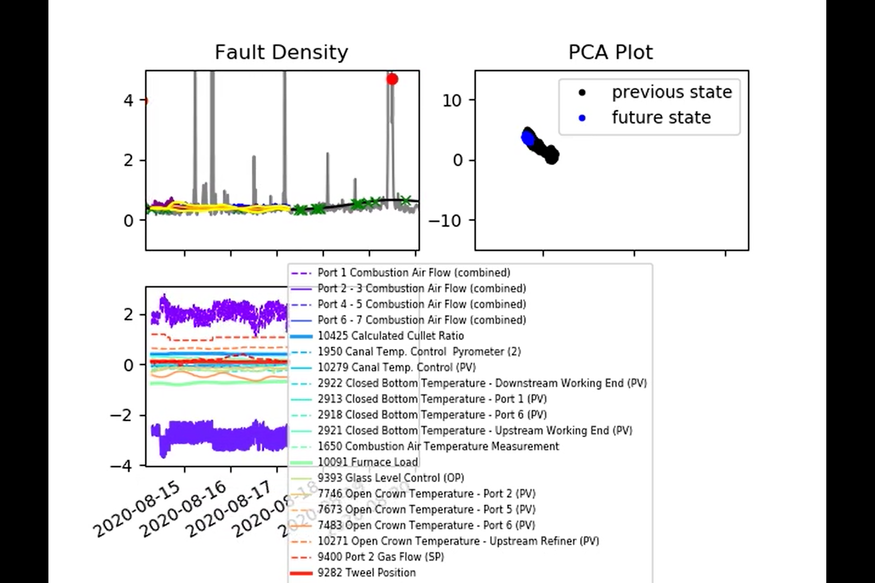
MK4 Fault Scanner Data
Model now ignores stripes instead of coating periods.
New video: 2021-06-07_results.mp4 now on sharepoint.
Gaussian Process now includes 3 sigma confidence bounds. Not that they can vary depending on the ‘closeness’ to the training data.

Slide 8
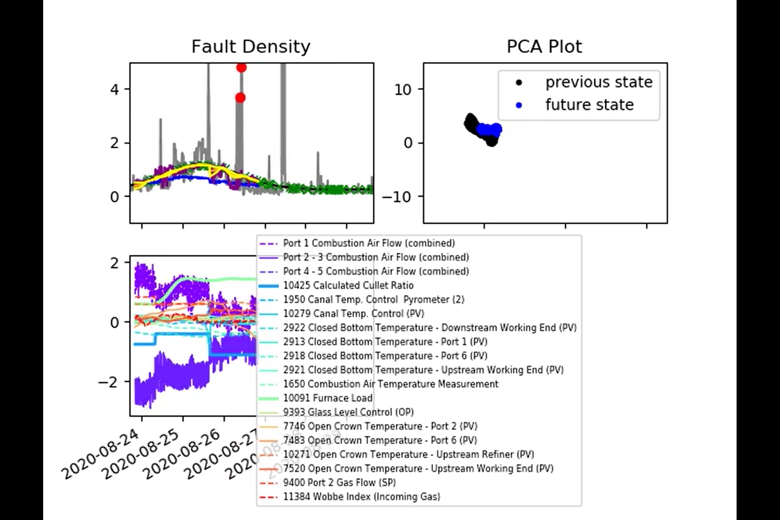
MK4 Fault Scanner Data
New video: 2021-06-07_results.mp4 now on sharepoint.

Slide 9
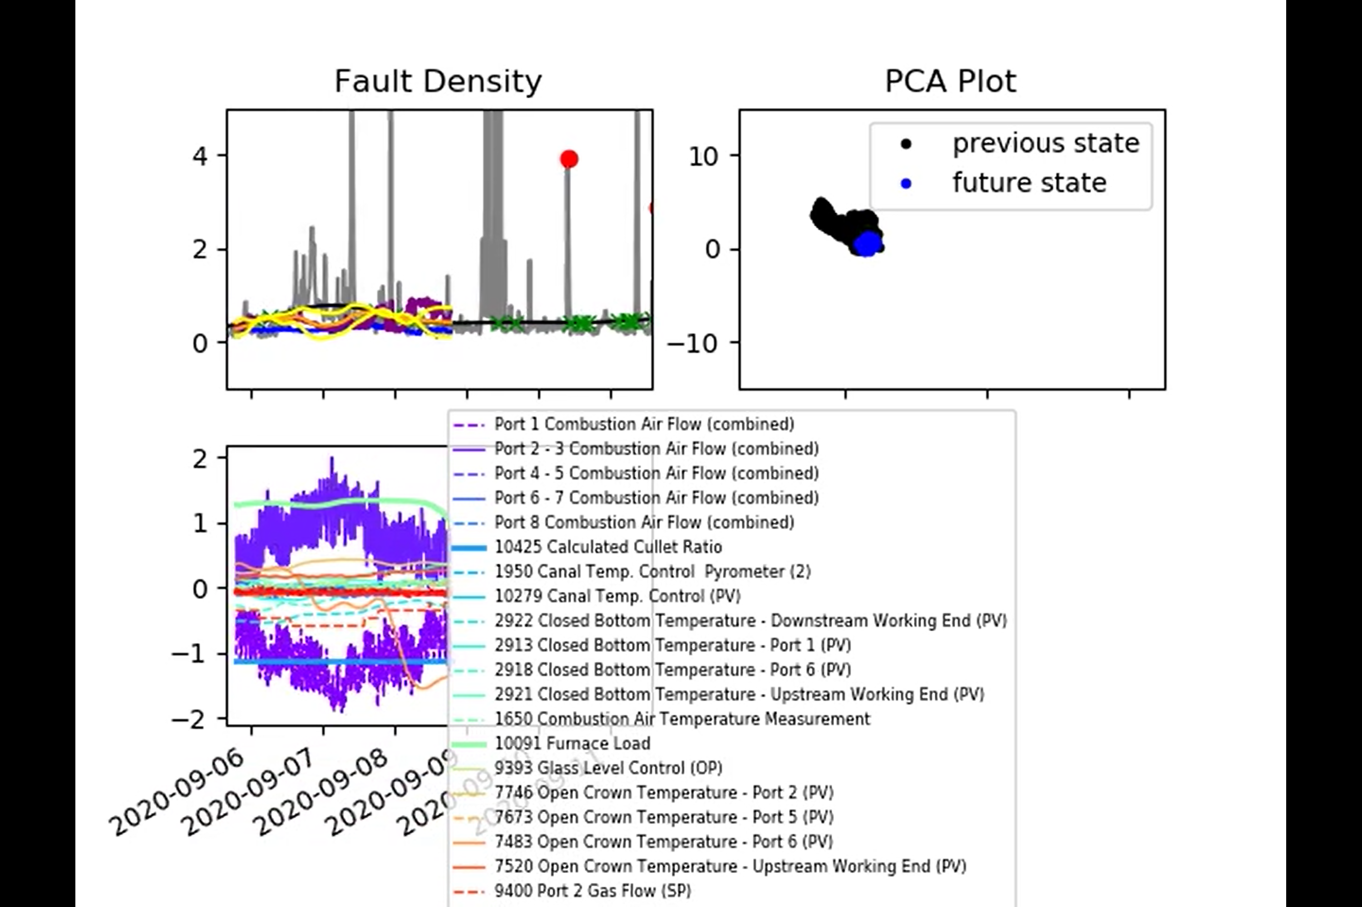
MK4 Fault Scanner Data
New video: 2021-06-07_results.mp4 now on sharepoint.

Slide 10
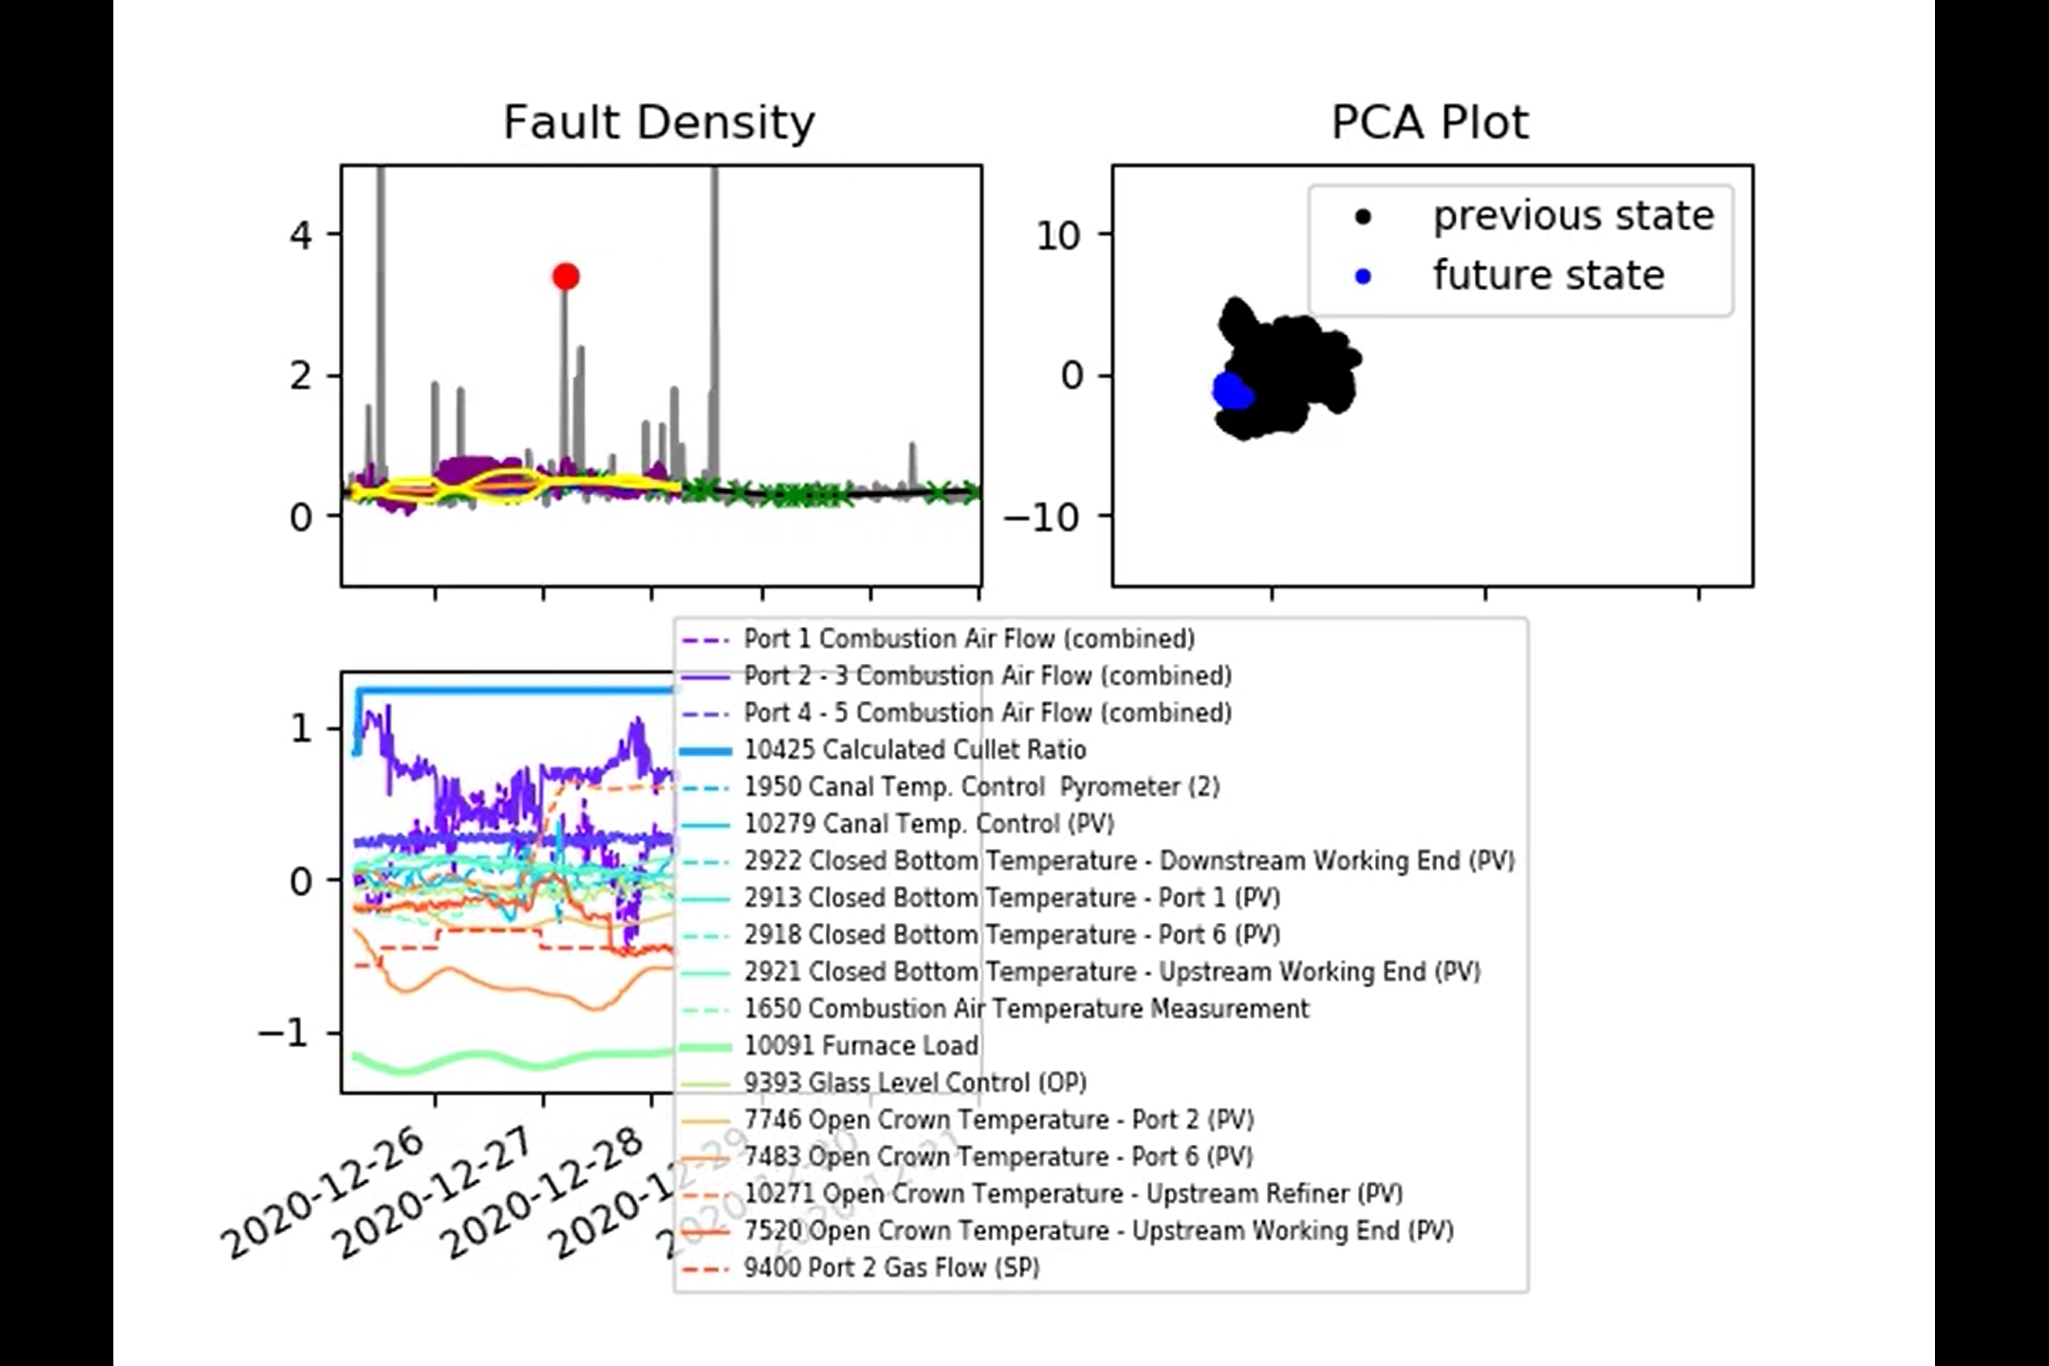
MK4 Fault Scanner Data
New video: 2021-06-07_results.mp4 now on sharepoint.

Slide 11
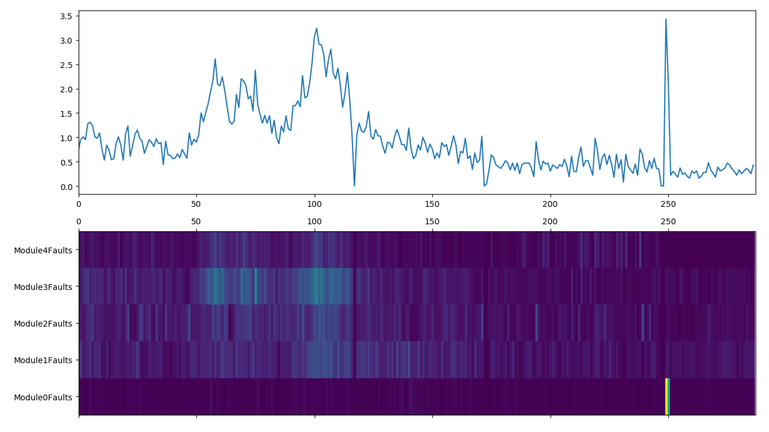
ISRA 5D Fault Scanner Data
2020/08/24 to 2020/08/28:
No obvious spikes in the x-direction here.
A suspect stripe in the y-direction?
An obvious outlier.

Slide 12
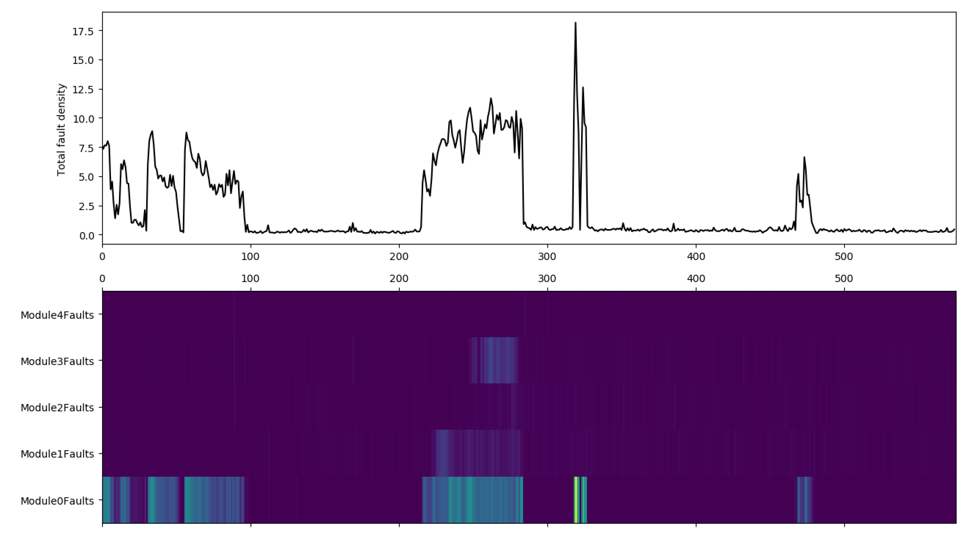
ISRA 5D Fault Scanner Data
2020/09/03 to 2020/09/11:
Clearly these look fairly suspect.
The next results focusses on this time period, specifically on Module 0 for now.

Slide 13
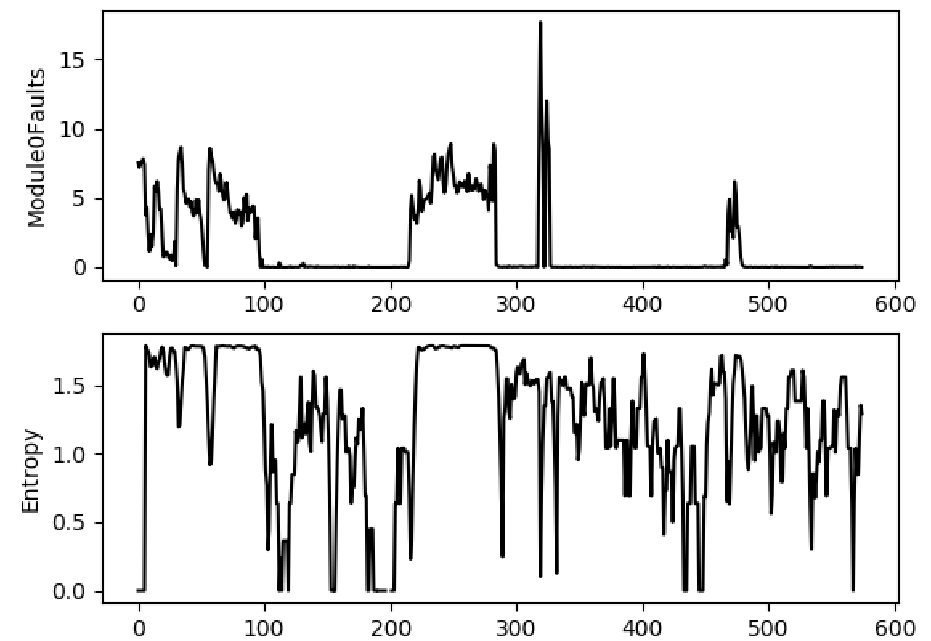
ISRA 5D Fault Scanner Data
Here we’re looking at the entropy of the data from now, concatenated with the previous 5 data points.
Perhaps a threshold of entropy > 1.5 and summation of in the window > 2 ?

Slide 14
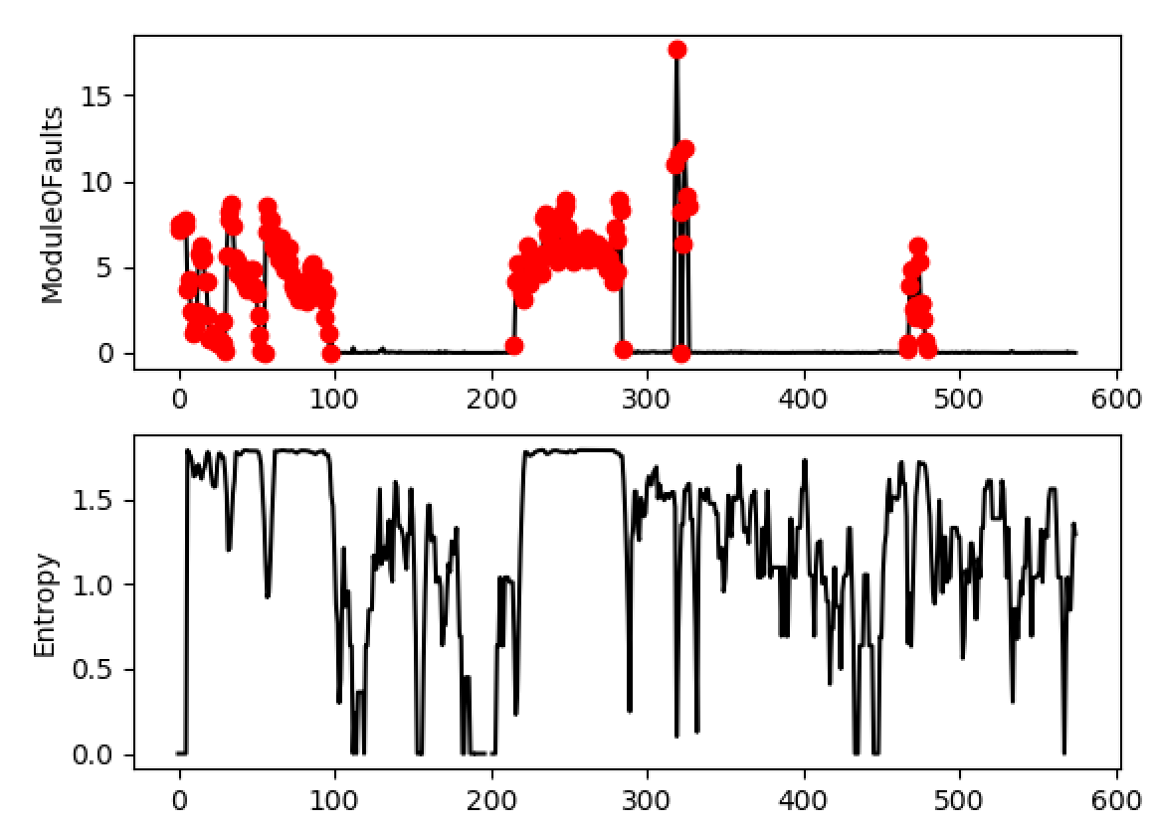
ISRA 5D Fault Scanner Data
Results look reasonable ‘by eye’.
What about module 1?

Slide 15
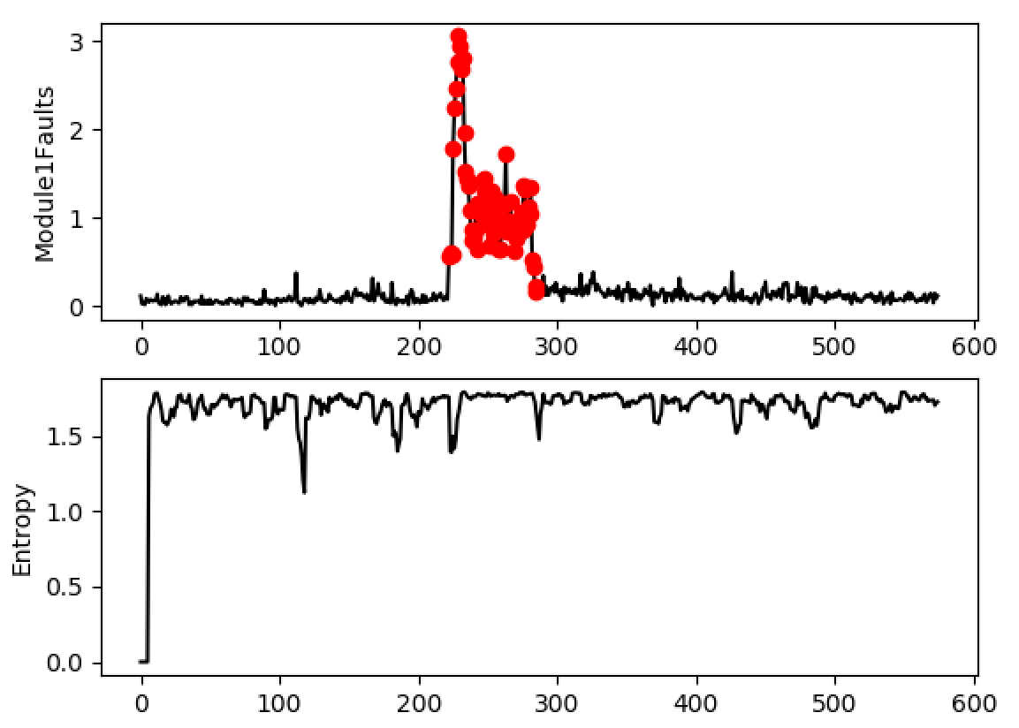
ISRA 5D Fault Scanner Data
High entropy for most of the data (i.e. it is very uniform) but we only pick out this region of high fault density.
Next we apply this process to each module, setting each red point equal to zero, and study how the total fault density changes as a result.

Slide 16
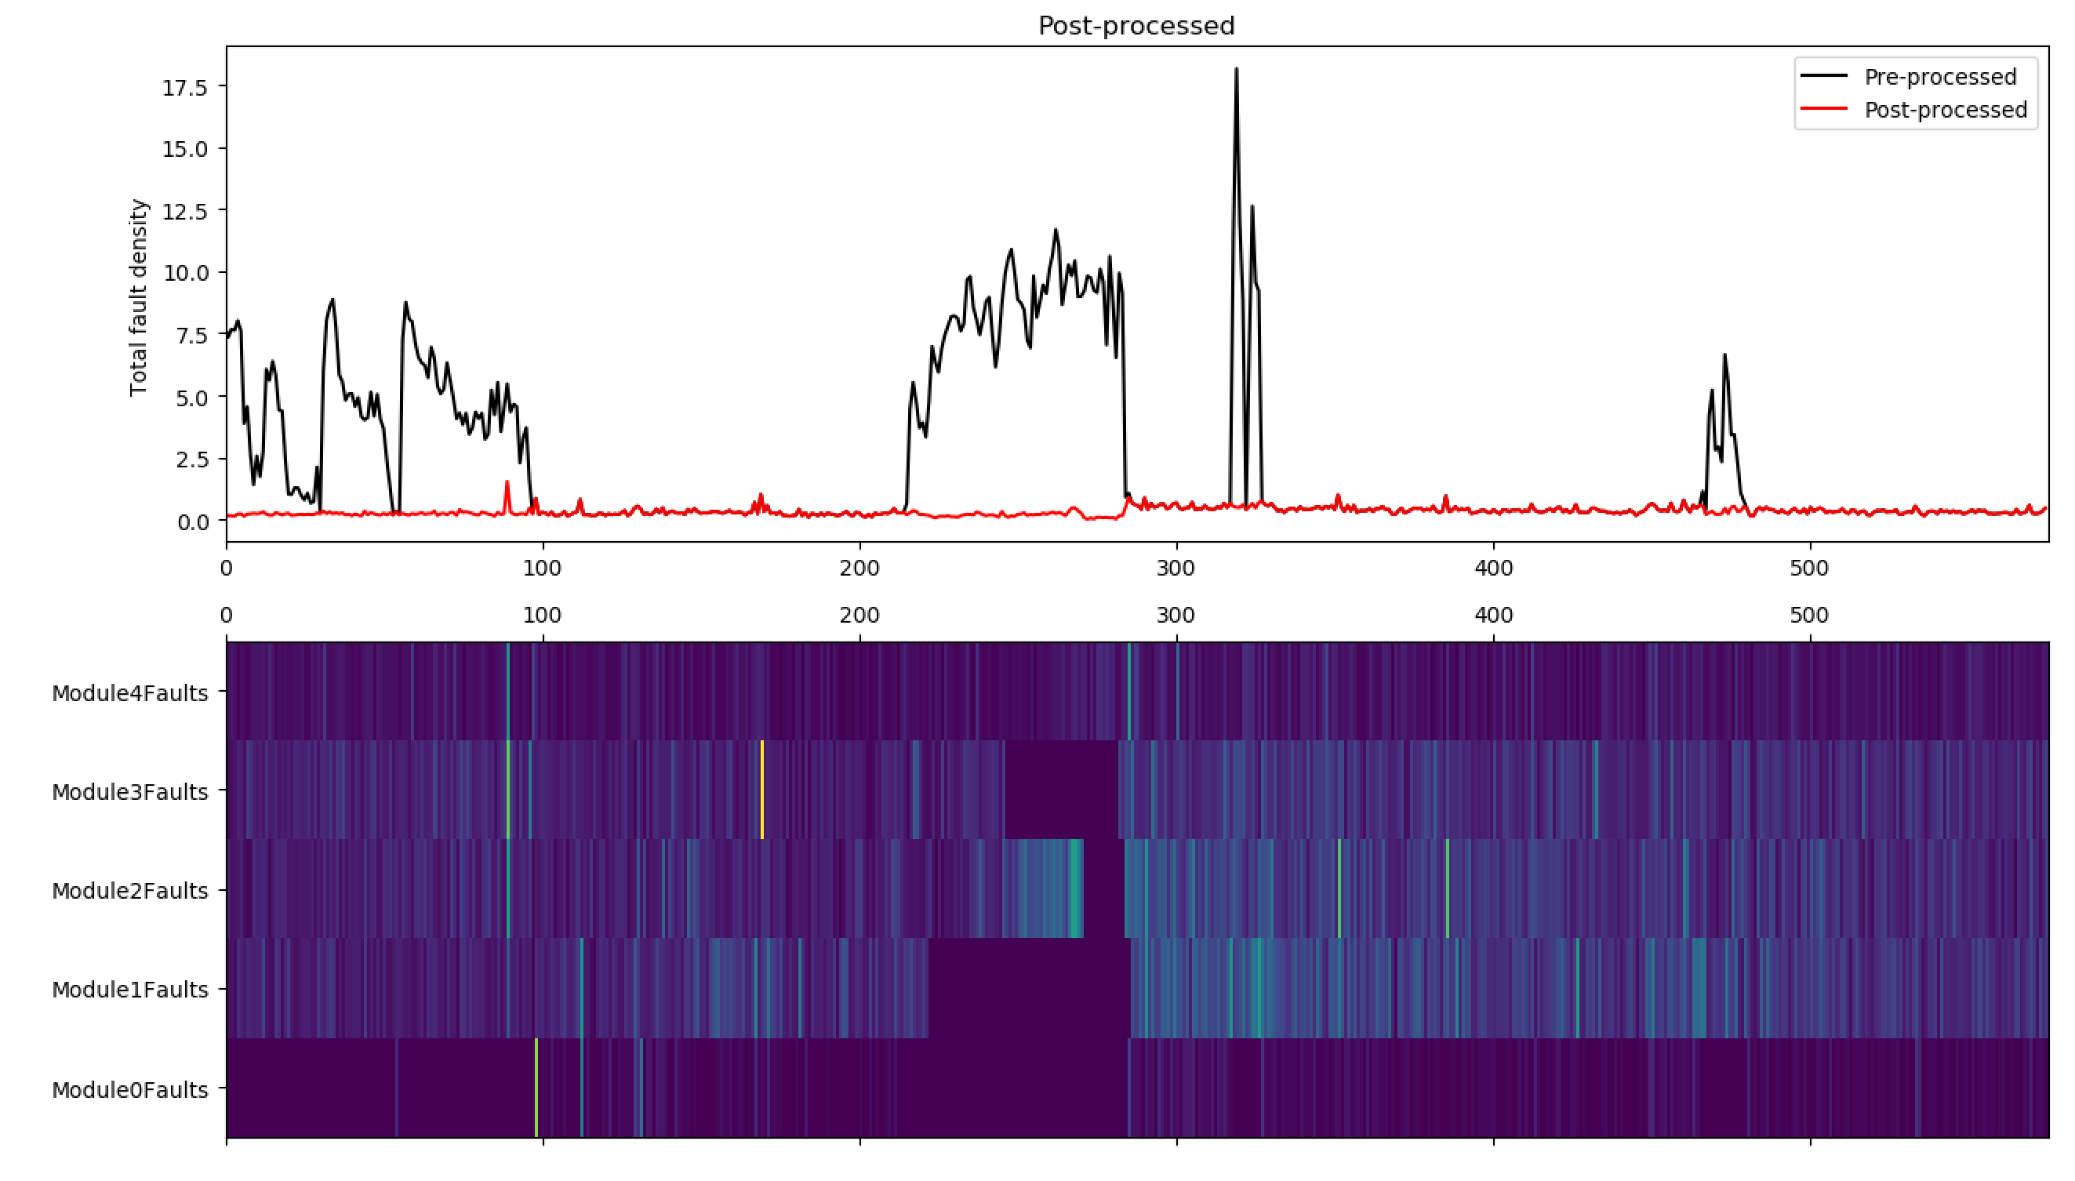
ISRA 5D Fault Scanner Data

Slide 17
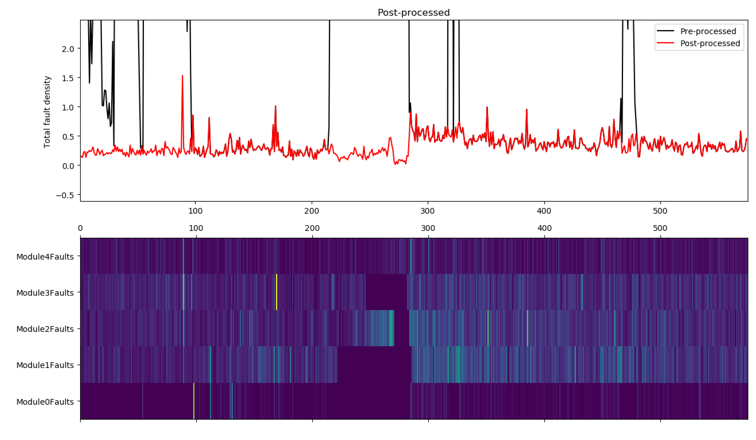
ISRA 5D Fault Scanner Data

Slide 18
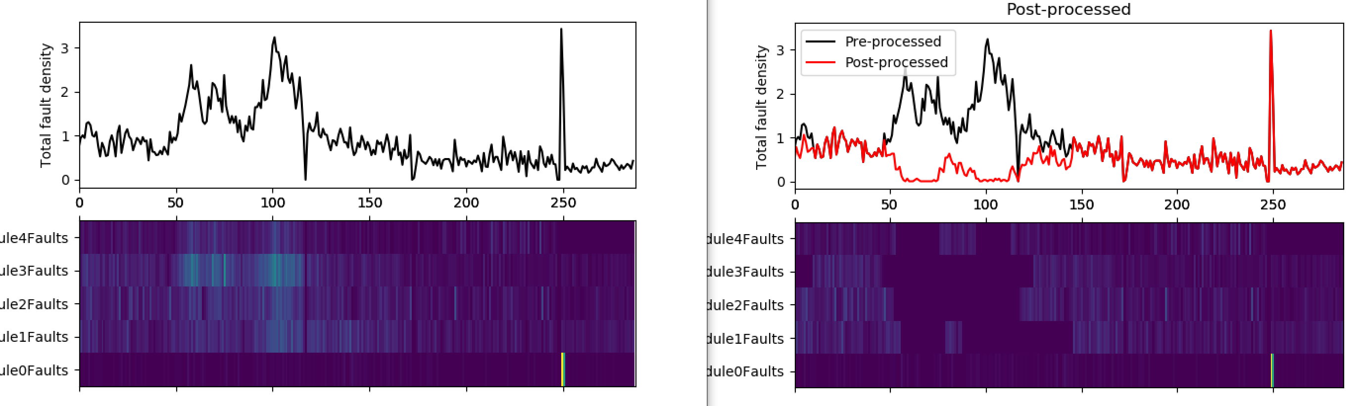
ISRA 5D Fault Scanner Data
Repeating again for the region 2020/08/24 : 2020/08/28
The entropy criterion isn’t quite right and we have removed a real rise in fault density by mistake.

Slide 19
ISRA 5D Fault Scanner Data
Most thorough way to do this would be to label some of the points manually and then use a classification algorithm to find the decision boundary.
We also see a lot of spikes that are due to high values present in only one module. Should we remove these directly rather than relying on our remove_spikes method?

Slide 20
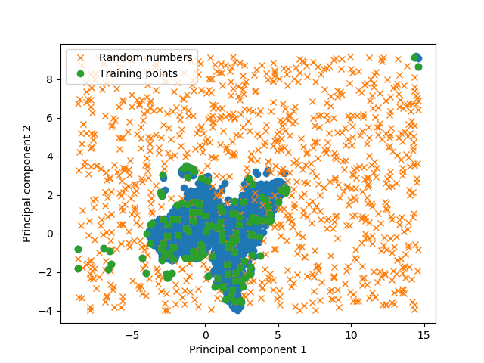
GP Confidence Bounds
Choosing training data points using the PCA plot drawn for the highest relevance input set
The PCA plot, drawn for the highest relevance input set, spans over a limited region compared to the previous PCA plot

Slide 21
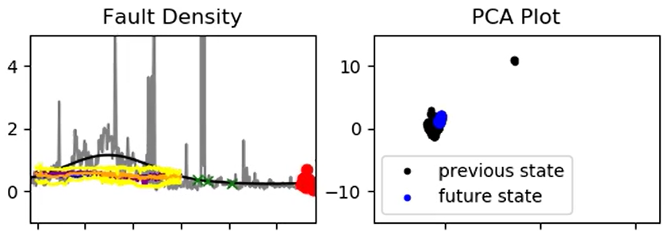
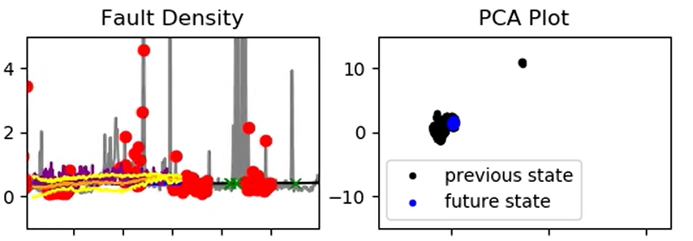
GP Confidence Bounds
Predicted furnace faults using GP with confidence bounds
We no longer have training points in some regions of interest
2020-08-24 to 08-29
2020-09-06 to 09-11

Slide 22
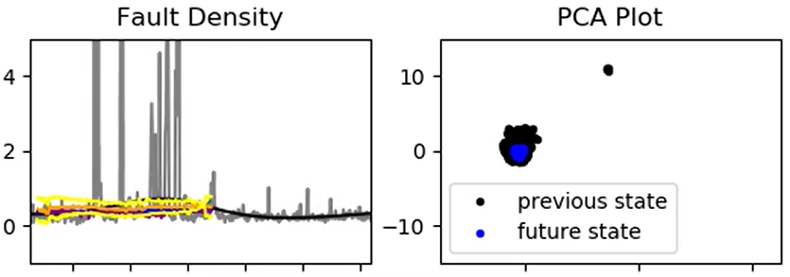
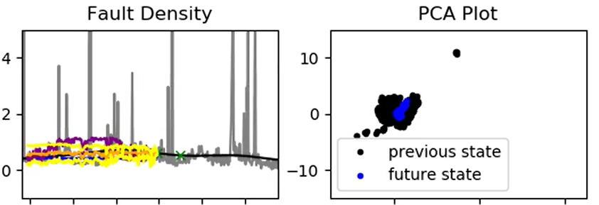
GP with lower relevance inputs removed
Predicted furnace faults using GP with confidence bounds
2020-10-21 to 10-26
2020-12-07 to 12-12

Slide 23
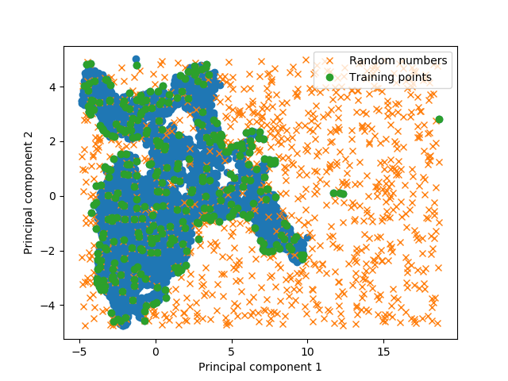
GP with lower relevance inputs removed
Choosing training data points using the PCA plot drawn for all the inputs
As the PCA plot, drawn for the highest relevance input set, did not capture sufficient number of training points in regions of interest PCA plot was re-drawn with all the inputs

Slide 24
GP with lower relevance inputs removed
Automatic relevance determination
Inputs | Relevance
10425 Calculated Cullet Ratio | 2.05621579e+05
1950 Canal Temp. Control Pyrometer (2) | 2.21899398e+05
10279 Canal Temp. Control (PV) | 1.89523128e+05
2922 Closed Bottom Temperature - Downstream Working End (PV) | 2.73067996e+05
2913 Closed Bottom Temperature - Port 1 (PV) | 1.28543857e+05
2918 Closed Bottom Temperature - Port 6 (PV) | 2.29216205e+00
2921 Closed Bottom Temperature - Upstream Working End (PV)', | 1.51626988e+05
1650 Combustion Air Temperature Measurement | 9.64146959e+04
10091 Furnace Load | 4.84243934e+04
15119 Furnace Pressure (PV) | 1.64999914e+05
9393 Glass Level Control (OP) | 1.50915905e+05
7546 Open Crown Temperature - Port 1 (PV) | 1.77042536e+05
7746 Open Crown Temperature - Port 2 (PV) | 1.21937064e+05
7673 Open Crown Temperature - Port 5 (PV) | 4.90795370e+00
7483 Open Crown Temperature - Port 6 (PV) | 1.40319504e+05
10271 Open Crown Temperature - Upstream Refiner (PV) | 1.62047046e+00
7520 Open Crown Temperature - Upstream Working End (PV) | 7.32822707e+04
9400 Port 2 Gas Flow (SP) | 3.03175033e+00
9282 Tweel Position | 1.09005557e+05
A Slightly different highly relevant input set was recognised
(due to random selection of training points)

Slide 25
GP with lower relevance inputs removed
Automatic relevance determination
Inputs | Relevance
11384 Wobbe Index (Incoming Gas)' | 2.15193652e+05
Port 1 Combustion Air Flow (combined) | 2.32525817e+05
Port 2 - 3 Combustion Air Flow (combined) | 6.58910088e-01
Port 4 - 5 Combustion Air Flow (combined) | 3.21284597e+00
Port 6 - 7 Combustion Air Flow (combined) | 4.46250792e+04
Port 8 Combustion Air Flow (combined) | 1.04850351e+00
200000 Front Wall Temperature Average (PV) | 1.09405581e+05
Regenerator Crown Temperature Port 2 (abs. difference) | 9.76303076e-01
Regenerator Crown Temperature Port 4 (abs. difference) | 1.14024371e+05
Regenerator Crown Temperature Port 6 (abs. difference) | 1.65652342e+05
Regenerator Crown Temperature Port 8 (abs. difference) | 3.09356255e+00
Regenerator Base Temperature Port 1 (abs. difference) | 1.39029705e+00
Regenerator Base Temperature Port 2 (abs. difference) | 7.64842189e+04
Regenerator Base Temperature Port 3 (abs. difference) | 1.28555971e+00
Regenerator Base Temperature Port 4 (abs. difference) | 3.78308169e+04
Regenerator Base Temperature Port 5 (abs. difference) | 1.20256439e+05
Regenerator Base Temperature Port 6 (abs. difference) | 6.53676451e-01
Regenerator Base Temperature Port 7 (abs. difference) | 6.73636952e+04
Regenerator Base Temperature Port 8 (abs. difference) | 9.33809277e+04

Slide 26
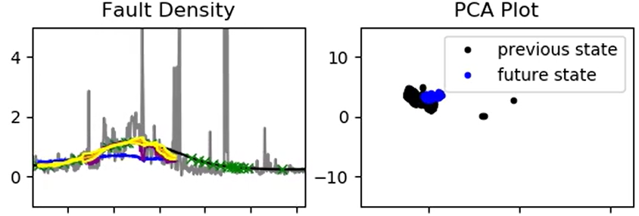
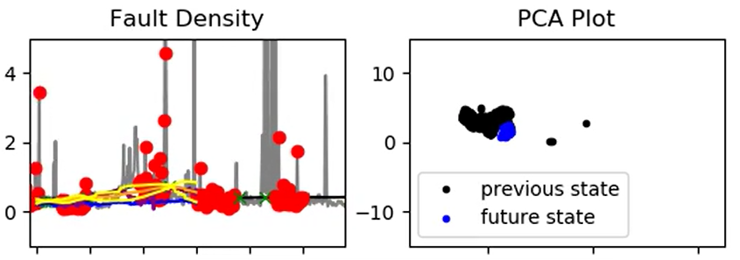
GP with lower relevance inputs removed
Predicted furnace faults using GP with confidence bounds
GP was re-trained after removing lower relevance inputs and predicted fault density with the recognised highest relevance inputs
2020-08-24 to 08-29
2020-09-06 to 09-11

Slide 27
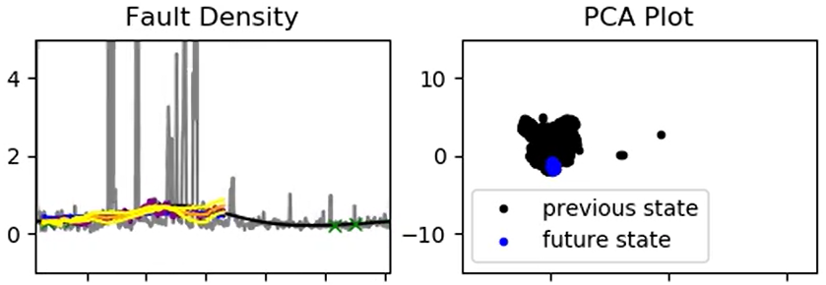
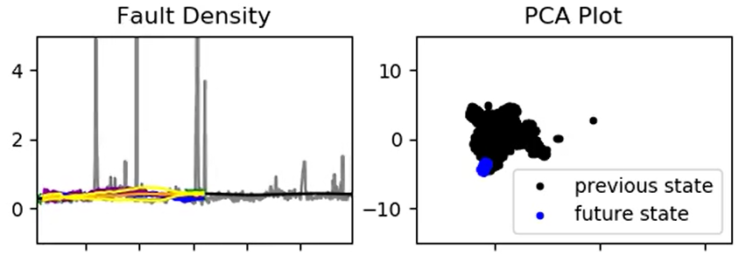
GP with lower relevance inputs removed
Predicted furnace faults using GP with confidence bounds
2020-10-21 to 10-26
2020-11-30 to 12-04

Slide 28
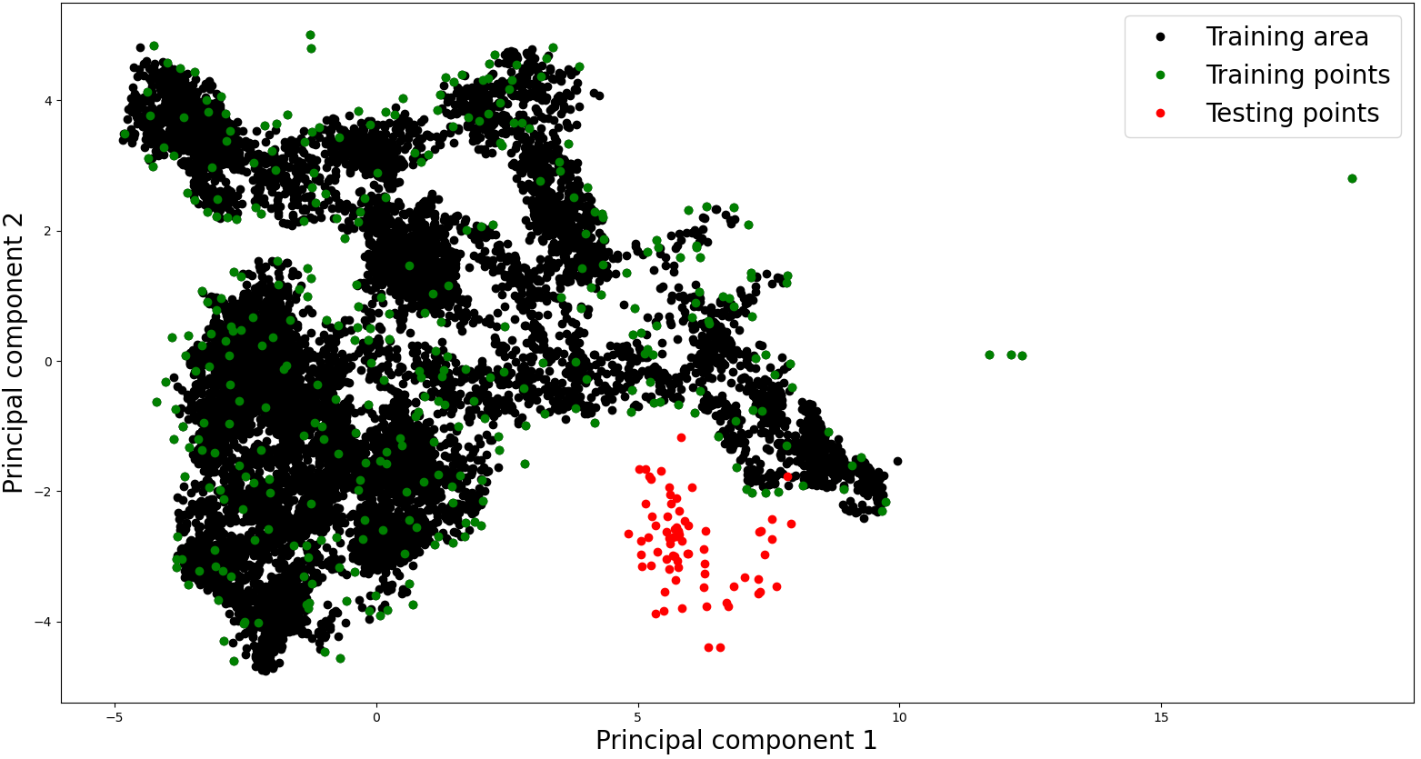
Testing data (18/05/2021 to 27/05/2021)
Day | From | To
1 | 18/05/2021 | 19/05/2021
2 | 19/05/2021 | 20/05/2021
3 | 20/05/2021 | 21/05/2021
4 | 21/05/2021 | 22/05/2021
5 | 23/05/2021 | 24/05/2021
6 | 24/05/2021 | 25/05/2021
7 | 25/05/2021 | 26/05/2021
8 | 26/05/2021 | 27/05/2021
1

Slide 29
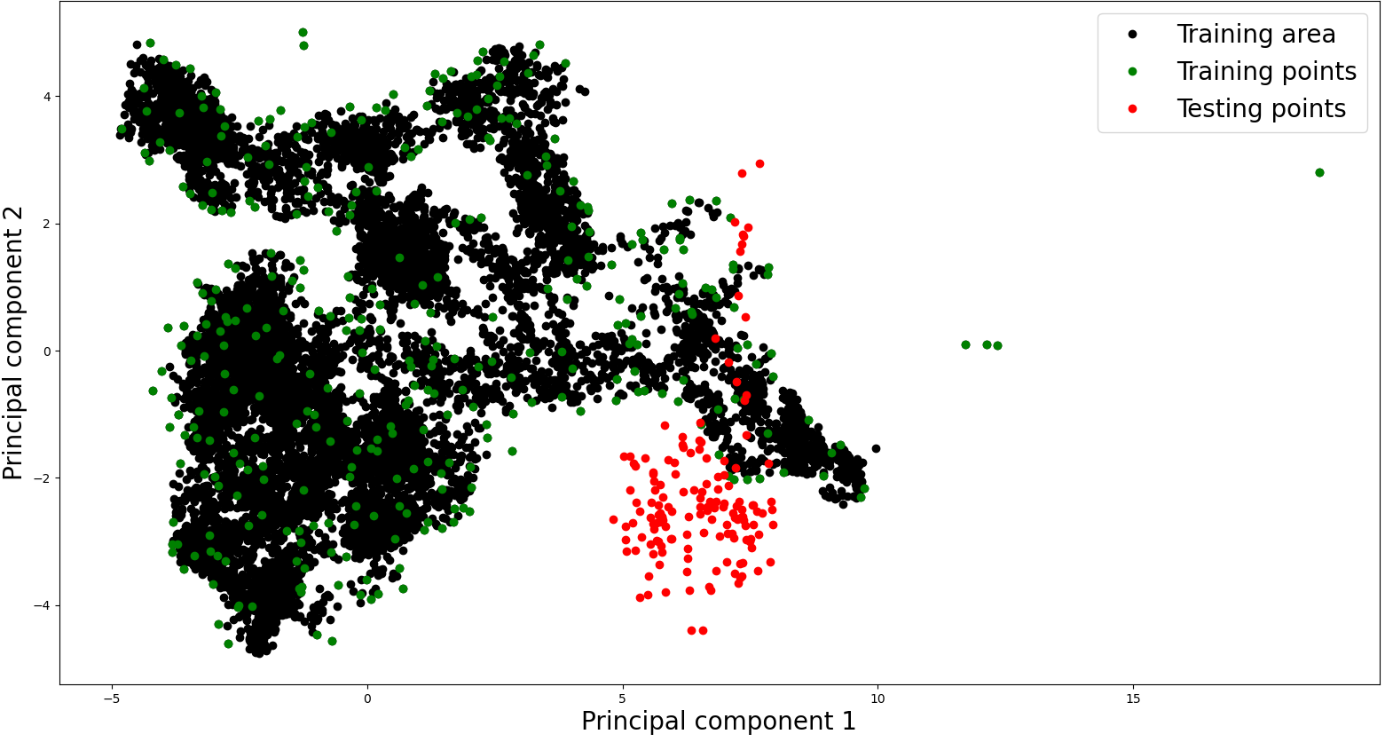
Testing data (18/05/2021 to 27/05/2021)
2
Day | From | To
1 | 18/05/2021 | 19/05/2021
2 | 19/05/2021 | 20/05/2021
3 | 20/05/2021 | 21/05/2021
4 | 21/05/2021 | 22/05/2021
5 | 23/05/2021 | 24/05/2021
6 | 24/05/2021 | 25/05/2021
7 | 25/05/2021 | 26/05/2021
8 | 26/05/2021 | 27/05/2021
1

Slide 30
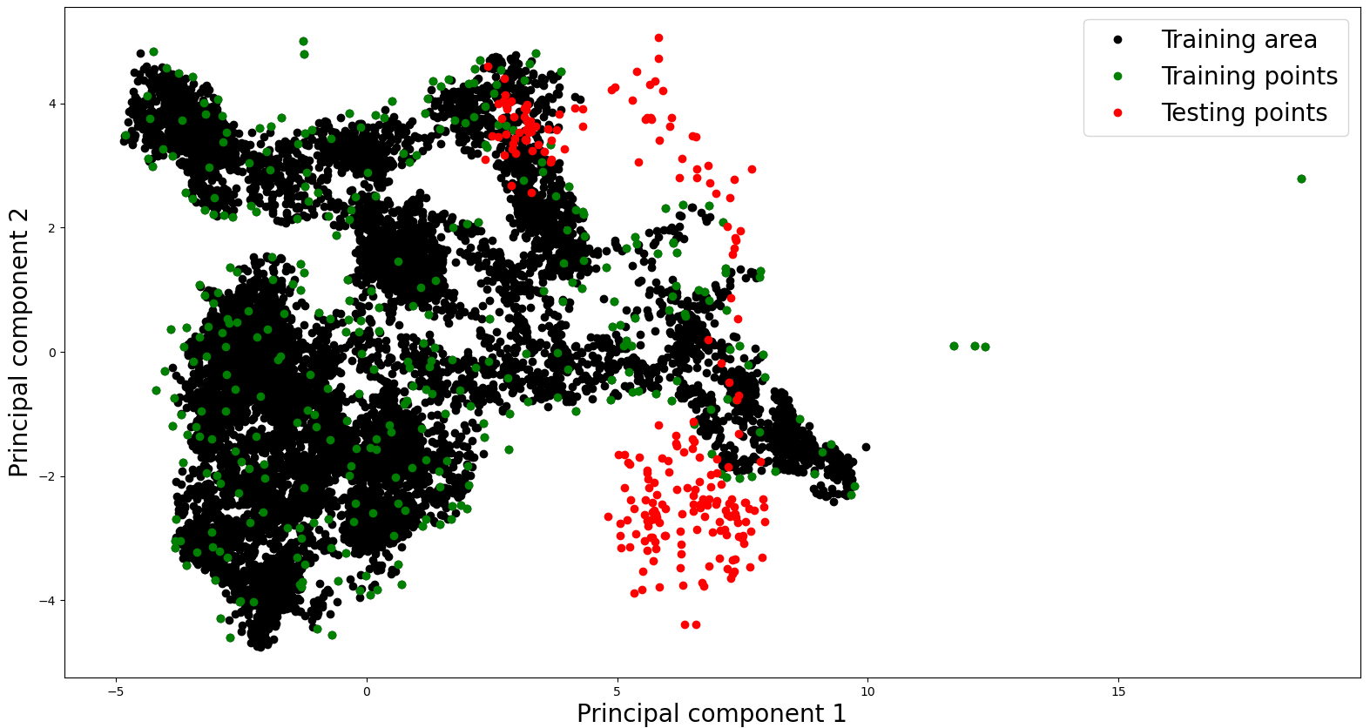
Testing data (18/05/2021 to 27/05/2021)
3
2
Day | From | To
1 | 18/05/2021 | 19/05/2021
2 | 19/05/2021 | 20/05/2021
3 | 20/05/2021 | 21/05/2021
4 | 21/05/2021 | 22/05/2021
5 | 23/05/2021 | 24/05/2021
6 | 24/05/2021 | 25/05/2021
7 | 25/05/2021 | 26/05/2021
8 | 26/05/2021 | 27/05/2021
1

Slide 31
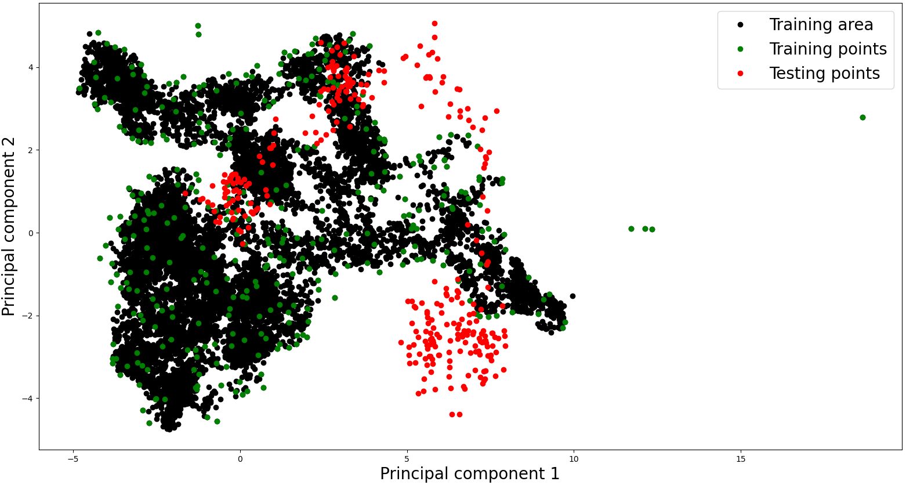
Testing data (18/05/2021 to 27/05/2021)
3
4
2
2
Day | From | To
1 | 18/05/2021 | 19/05/2021
2 | 19/05/2021 | 20/05/2021
3 | 20/05/2021 | 21/05/2021
4 | 21/05/2021 | 22/05/2021
5 | 23/05/2021 | 24/05/2021
6 | 24/05/2021 | 25/05/2021
7 | 25/05/2021 | 26/05/2021
8 | 26/05/2021 | 27/05/2021
1
1

Slide 32
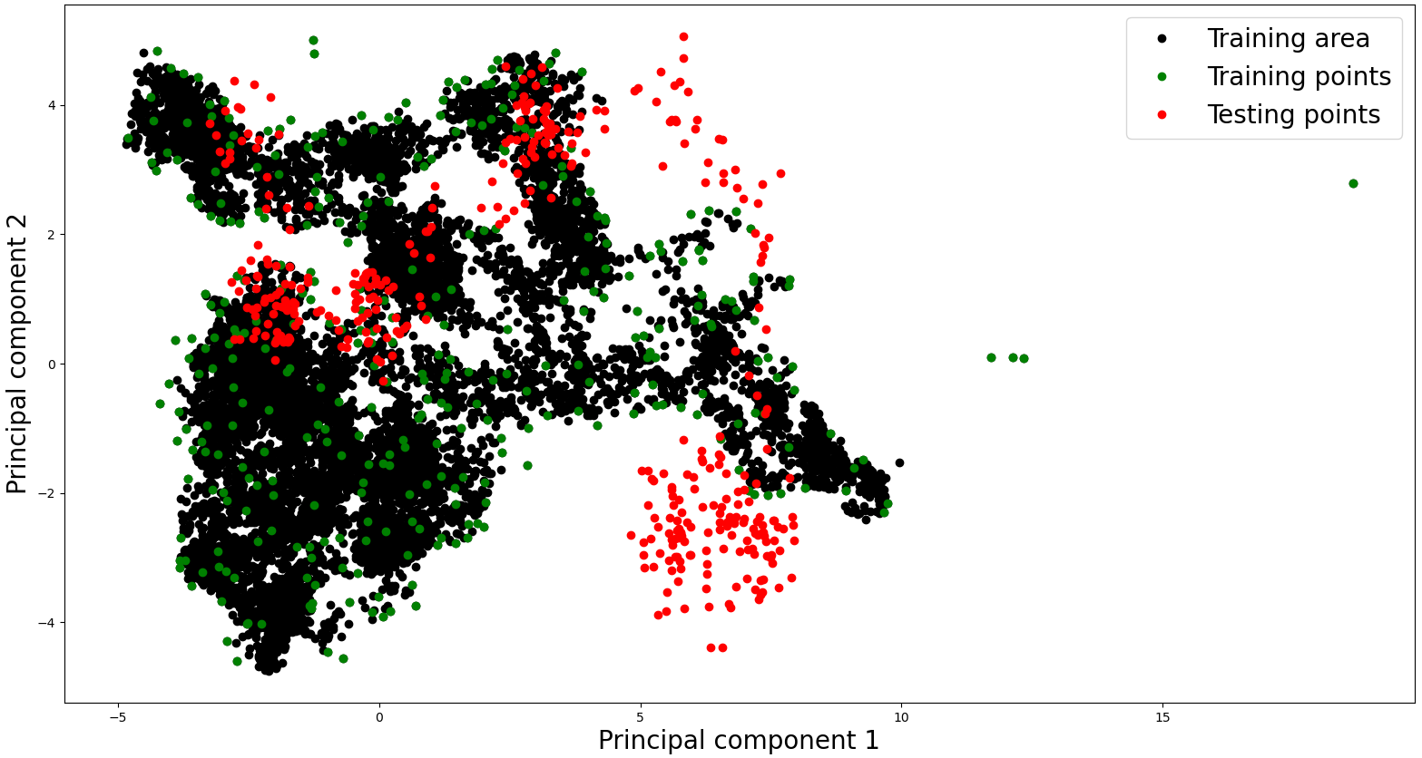
Testing data (18/05/2021 to 27/05/2021)
3
4
5
2
Day | From | To
1 | 18/05/2021 | 19/05/2021
2 | 19/05/2021 | 20/05/2021
3 | 20/05/2021 | 21/05/2021
4 | 21/05/2021 | 22/05/2021
5 | 23/05/2021 | 24/05/2021
6 | 24/05/2021 | 25/05/2021
7 | 25/05/2021 | 26/05/2021
8 | 26/05/2021 | 27/05/2021
1

Slide 33
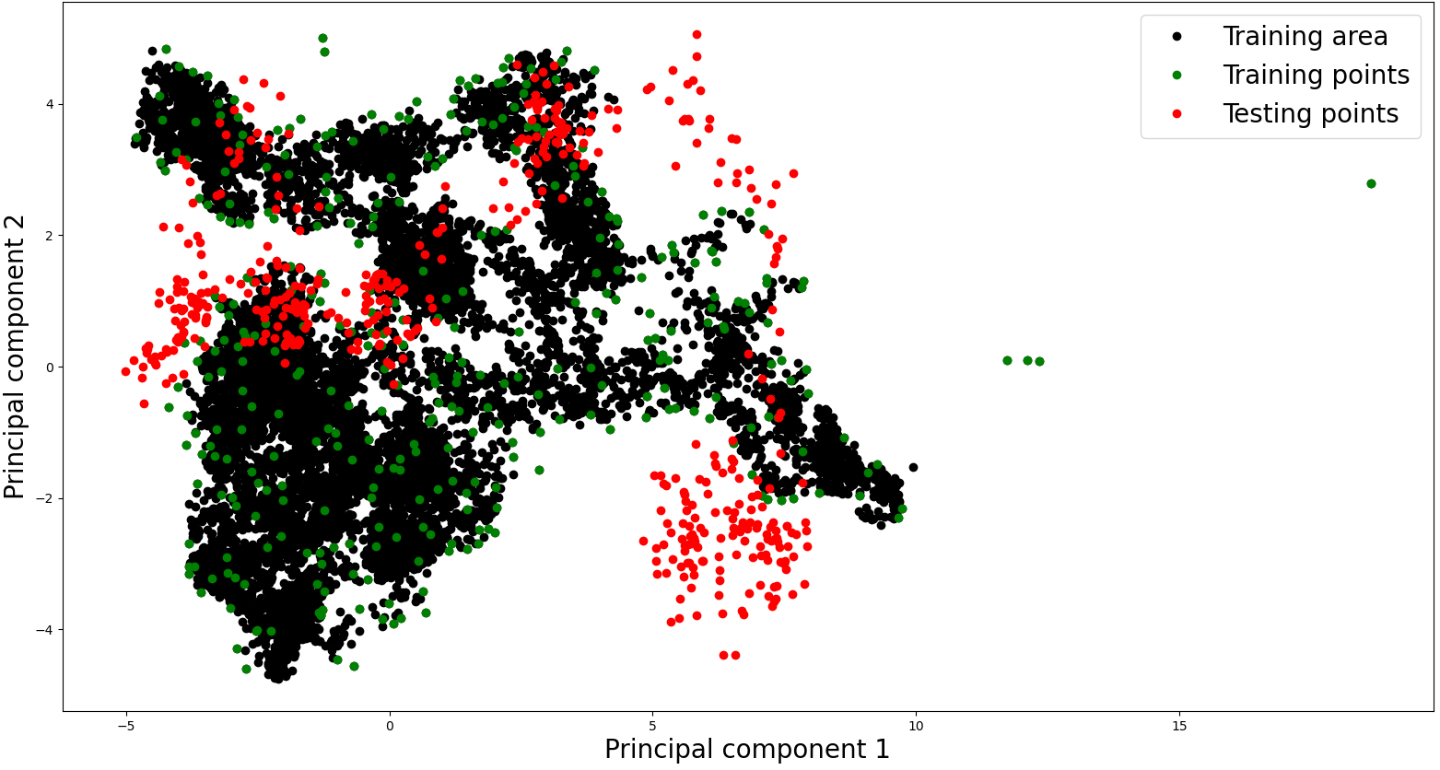
Testing data (18/05/2021 to 27/05/2021)
3
4
5
6
2
Day | From | To
1 | 18/05/2021 | 19/05/2021
2 | 19/05/2021 | 20/05/2021
3 | 20/05/2021 | 21/05/2021
4 | 21/05/2021 | 22/05/2021
5 | 23/05/2021 | 24/05/2021
6 | 24/05/2021 | 25/05/2021
7 | 25/05/2021 | 26/05/2021
8 | 26/05/2021 | 27/05/2021
1

Slide 34
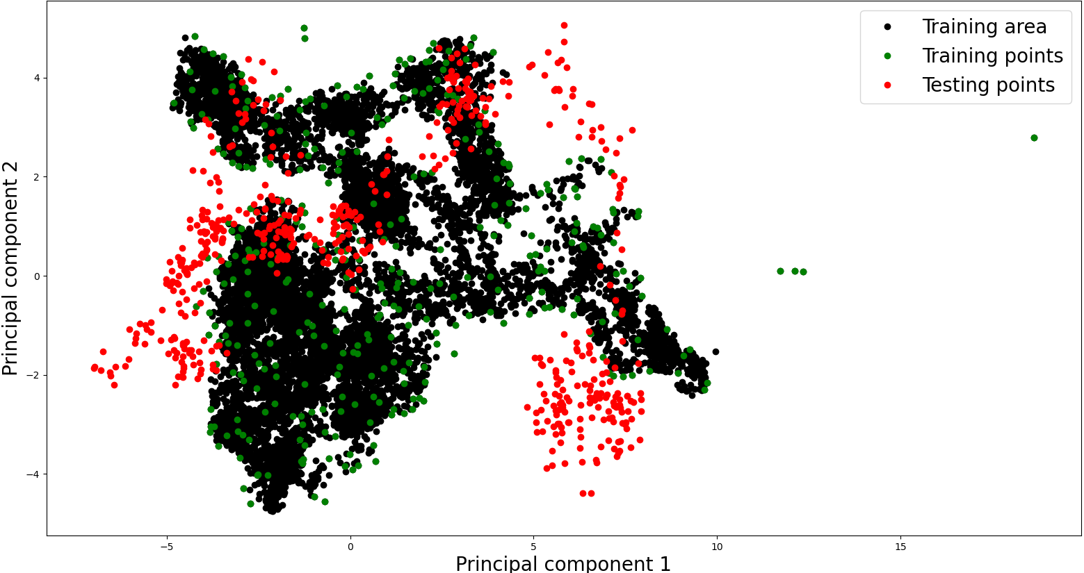
Testing data (18/05/2021 to 27/05/2021)
3
4
5
6
2
Day | From | To
1 | 18/05/2021 | 19/05/2021
2 | 19/05/2021 | 20/05/2021
3 | 20/05/2021 | 21/05/2021
4 | 21/05/2021 | 22/05/2021
5 | 23/05/2021 | 24/05/2021
6 | 24/05/2021 | 25/05/2021
7 | 25/05/2021 | 26/05/2021
8 | 26/05/2021 | 27/05/2021
7
1

Slide 35
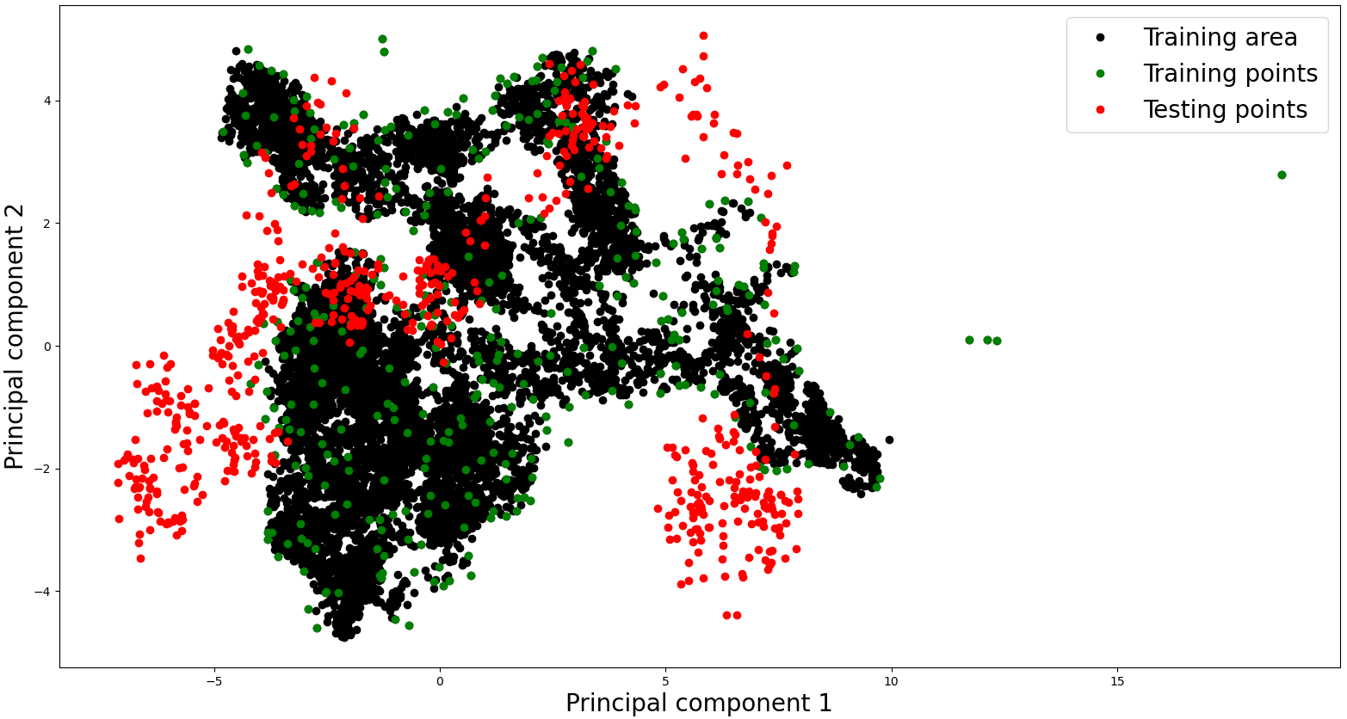
Testing data (18/05/2021 to 27/05/2021)
3
4
4
5
5
6
2
Day | From | To
1 | 18/05/2021 | 19/05/2021
2 | 19/05/2021 | 20/05/2021
3 | 20/05/2021 | 21/05/2021
4 | 21/05/2021 | 22/05/2021
5 | 23/05/2021 | 24/05/2021
6 | 24/05/2021 | 25/05/2021
7 | 25/05/2021 | 26/05/2021
8 | 26/05/2021 | 27/05/2021
7
8
1
4 days of data correspond to furnace states that the model has not seen

Slide 36
Testing data (18/05/2021 to 27/05/2021)
Video: Models predictive performance in the test data

Slide 37
Thank you for your attention. ANY QUESTIONS?

